Slide 1






WINRIDGE ELEMENTARY SCHOOL
2023-2024
Title One and Parent Information Meeting
Winning is the Wildcat Way!
August 23 and 24, 2023

Slide 2

Welcome Back Wildcats!

Slide 3
Mission: Winridge Elementary School’s mission is to provide a structured environment that will prepare students to become college and career ready.
Vision: Winridge Elementary School, together with ALL stakeholders, will maintain a safe and high performing school where ALL students demonstrate good character, wellness, and academic proficiency.
Mission and Vision Statements

Slide 4
Be Responsible
Be Courteous
Be Safe
Be Respectful
Be Prepared
WINRules

Slide 5


Administration
Dr. T. Shaffer, Principal
H. Harley, Assistant Principal
S. Jarrett, PLC Coach
Professional School Counselor
S. Johnson
School Social Worker
B. Leigh
Office Staff
J. McCullough
People to Know

Slide 6
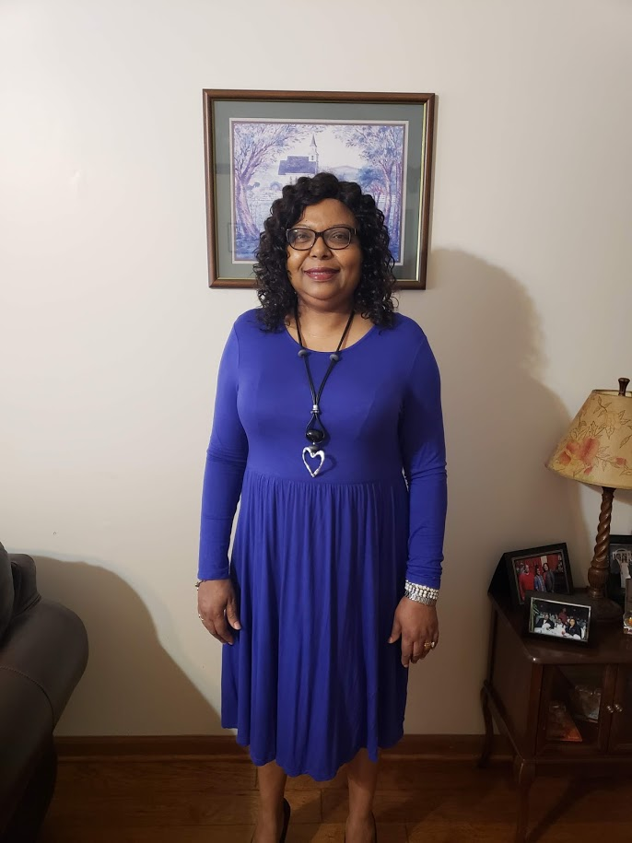
Meet our School Social Worker:
Ms. Beverly Leigh, LCSW, LSSW
Leighbj@scsk12.org
901-416-7032
Roles and Responsibilities
Provide individual, group and family therapy
Respond to Emergencies and Crisis
Provide consultation with teachers, parents administrators, and others
Complete FBA/BIP’s, Safety Plans as indicated
Attend IEP’s/SART/504/ Team Meetings as needed

Slide 7





Agenda
What is Title 1 Purpose and Goals
How Title 1 Works
School/Parent Compact, FEP & Student Code of Conduct-
  (Each Parent received a copy of these forms August 23rd )
Parent’s Right to Know
Teacher Qualifications
Parental Involvement Policy
Availability of Parent Training/Opportunities for Meetings
Reporting Pupil Progress
P-T-Conferences
Mastery Connect Data
2023-2024 SIP Goals
State of the School
Questions and Answers

Slide 8
What is Title 1?
The purpose of Title I is to ensure that all students have a fair, equal, and significant opportunity to obtain a high-quality education and reach, at a minimum, proficiency on challenging State academic achievement standards and state academic assessments.
Title I is a program that is funded by the Federal Government that provides extra assistance to help students meet national and state achievement standards.

Slide 9
What is Title 1?
How it Works!
The federal government provides funding to states each year for Title I.
The State educational agencies send the money to the school district.
The local school district identifies eligible schools and provides Title I resources.
Title I serves children through Schoolwide Programs or Targeted Assistance Programs.
Goals
Increase academic achievement
Provide direct instructional support to students
Provide professional development for teachers
Promote parent education and involvement

Slide 10
Parent’s Right to Know
All parents have the right to request the following:
A teacher’s professional qualifications, licensure, grade(s) certification, waivers
A teacher’s baccalaureate and/or graduate degree, fields of endorsement, previous teaching experience
A paraprofessional’s qualifications
An annual notice of Student Education Records Privacy and notice for disclosure of School Directory Information
An assurance that their child’s name, address and telephone listing not be released to military recruiters
All parents will receive information on the following:
Their child’s level of achievement on each of the state’s academic assessments
Notification of right to transfer their child to another school in the district if the student becomes the victim of a violent crime or is assigned to an unsafe school
District Family Involvement Policy and School Parent Involvement Policy
Their right to public school choice, Supplemental Educational Services and more effective involvement if their child’s school is identified for school improvement

Slide 11
Parental Involvement
Parental Involvement Activities
Meet the Teacher Night
Room Parent
Parent/Teacher Conferences (1 each semester)
Various meetings (School Improvement Plan and PIE)
Parent Workshops (Ms. Johnson)
Family Events (Book Fair and Literacy Night)
Awards Assemblies (After each report card)
Invitations to classroom activities
End-of-Year Activities
Policy
Parents can become involved in the educational process by:
Regularly attending school events
Serving on the Parents In Education and on the School Improvement Plan Committee
Using talent and resources to enhance the instructional program

Slide 12
Parental Involvement
School/Parent Compact: An agreement that identifies the responsibilities of the school, the parent, and the student to ensure that all students are successful in all that they do.
Family Engagement Plan: A written plan jointly developed with parents and teachers and staff that outlines expectations for
parent and community involvement.

Slide 13

WES Home-School Compact

Slide 14
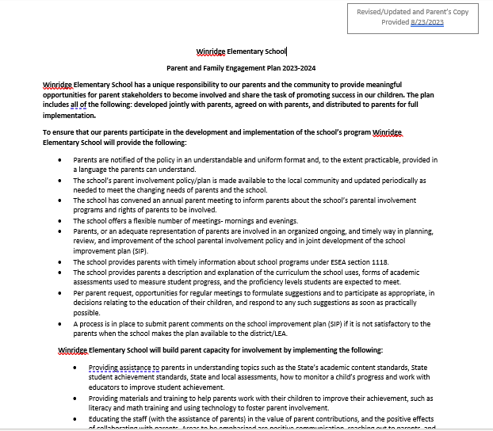
WES Parent and Family Engagement Plan

Slide 15
TN READY TCAP ASSESSMENT
Annual assessments play a key role in the teaching and learning process, and they are critical to ensure that all students are meeting higher standards and are making progress on their path to postsecondary and the workforce. The TCAP assessments are designed to provide Tennessee students, teachers, and families with better information about what students know and understand.
Each test (by subject) is divided into multiple subparts and will be administered on paper in a single administration window at the end of the school year.
English language arts (4 subparts) will consist of multiple choice and selected response items, as well as reading from texts and providing a written response.
Mathematics (3 subparts) will consist of multiple choice, multiple select, equation editor, matching tables, and graphing representations.
Science (1 subpart)

Slide 16
Additional Assessments:
Assessments are used to help teachers determine if a student is understanding the content presented in the classroom. In addition to TN Ready Assessment, we use the following for our students:
  Bi-Weekly standards-based tests in all core subjects K-5-Reading, Math, and Science tests
  I-Ready Diagnostic Assessment three times a year
  District Assessments (Mastery Connect) three times a year
  KK and 1st will not test (TN Ready)this school year

Slide 17
School-Wide Goals
Reading AMO 2023-2024 = 39%
Math AMO 2023-2024 = 45%
Science AMO 2023-2024 = 45%

Slide 18
WES Mastery Connect Spring Scores
ELA Mastery Connect Score= 47%
Math Mastery Connect Score = 40.4%
Science Mastery Connect Score = 37.7%

Slide 19
District/School Progress AYP Status
Winridge is a LEVEL 5 School in TVASS”
To Improve We Are Doing:
Weekly Small Group Instruction based on needs of the students
  Response to Intervention
  Daily standards-based instruction
  Bi-Weekly TN Ready formatted assessments
  Reteach Calendars

Slide 20
Reporting Pupil Progress
Winridge Elementary uses several avenues to report student progress:
Every 4 ½ weeks progress report-
          Sept 6, Nov 15, Jan 31, & Apr 17
Report cards every nine weeks-
Oct 25, Jan 17, Mar 27, & May 31
District Scheduled Parent-Teacher Conferences-
Sept 7 & Feb 15 (4pm-7pm)
Parent Power School Access
Special Note: Report Cards will be distributed & Available after 3:00p.m. via Parent Portal.
Parents may also set up conferences with individual teachers at any time during the school year*

Slide 21

School Information
School Hours 8:15 am -3:15 pm.
Homework Hotline-
  Call (901) 416-1234
  Hours-M-TH 4:00 pm -8:00pm
PowerSchool: https://scstn.powerschool.com/public/home.html
TECH Support-
  Call (901) 416-5300
  Hours 8:00 am -5:00 pm

Slide 22

Parent Communication
Newsletters
Flyers
Phone Blast
E-Mail
Letters
Social Media
School Website
Progress Reports
Class Dojo
Marquee
PowerSchool

Slide 23

Parental Involvement
We welcome parents and guardians who are interested in serving in an advisory capacity and will be organizing a parent group.
PLEASE CONTACT US!

Slide 24


Special Gifts Just for YOU!!
Third, Fourth, and Fifth Grade Parents
Kindergarten, First, and Second
Grade Parents

Slide 25
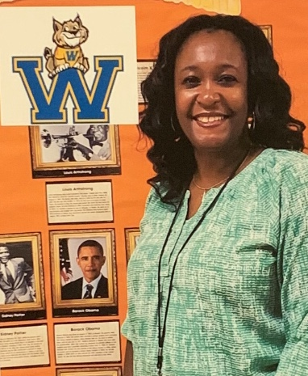
Meet our Professional School Counselor:
Ms. S. Johnson
Roles and Responsibilities
Student Advocate
Facilitate communication between home & school
Work closely with teachers to support students’ academic/social/emotional growth
Monitor student academic progress
Provide social/emotional support
Ms. Sheila Johnson
Room: Guidance Suite D 100 H
E-Mail Address: johnsonsi@scsk12.org
Phone: 901-416-7576 or
901-877-4280

Slide 26

What services do school counselors provide?
  Core Curriculum Lessons
  Individual Planning
    Goal setting
    Review Grades
  Responsive Services
    Individual Counseling
    Small Group Counseling
    Crisis Intervention
    Agency Referrals
  System Support
    Professional Development
    Consultation
    Advisory Councils

Slide 27


Student School-Wide Incentives
Incentive | Criteria | Frequency
Conduct Counts Parties | Students with 0-2 Conduct Slips | Every 20 Day Period
No Uniform Day/Jeans Day | Perfect Attendance for a 20 Day Period | After 20 Day Period
Catered Lunch | Proficiency on CFAs | Semester
Honors Program | Citizenship/Perfect Attendance | Every Quarter
Attendance Movie/Popcorn Parties | Perfect Attendance for 20 days | Every 20 Day Period

Slide 28
Winridge Elementary School Behavior/Discipline Flow Chart
0-2 Conduct Marks/Slips eligible for “Conduct Counts” Party
Contact parent/Guardian by phone and send letter home
0-2 Conduct Slips eligible for “Conduct Counts” Party
Parent is contacted and a Letter is sent home.
Conduct Slips #3
Documented meeting with Behavior Specialist, Counselor, Parent, Teacher, and Student
Conduct Slips #4
Referral to Guidance/Phone call home by Ms. Johnson

Slide 29
Winridge Elementary School
Behavior/Discipline Flow Chart
Conduct Mark/Slips #5
Office Disciplinary Referral-Student attends Supervised Study
Review School-Wide and Classroom Behavior Expectations
Student Completes I-Ready Math and Reading
Student Completes Unfinished Work, Accountability Writing Prompt
Mandatory Conference held Parent, Student, and Admin
Appropriate Consequence Given to Student
Conduct Mark/Slips #6

Slide 30
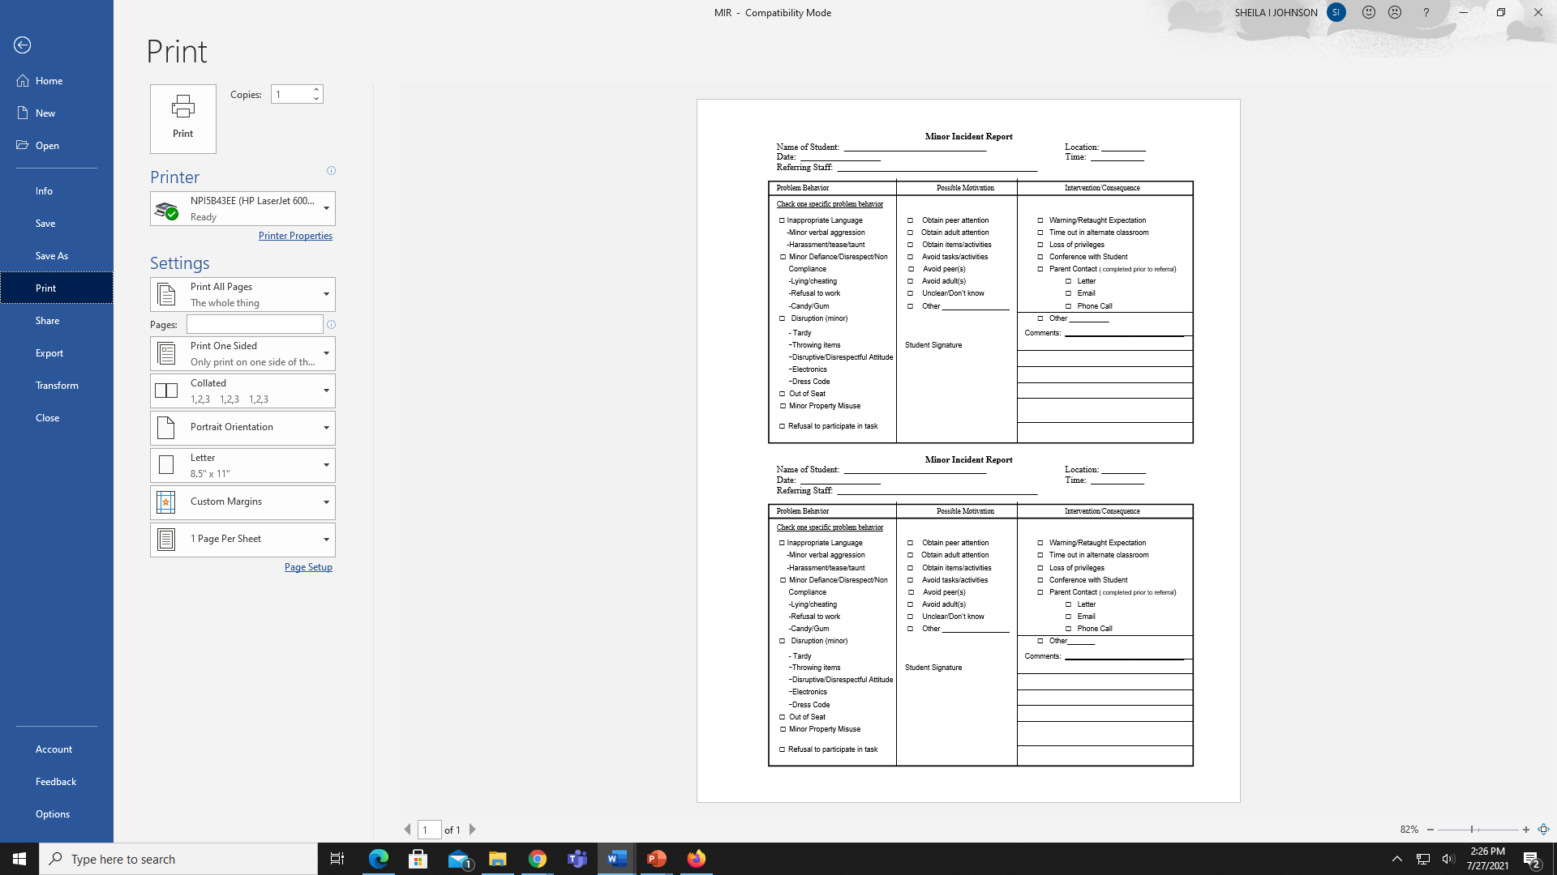
Winridge Minor Incident Form
(Conduct Slip)

Slide 31
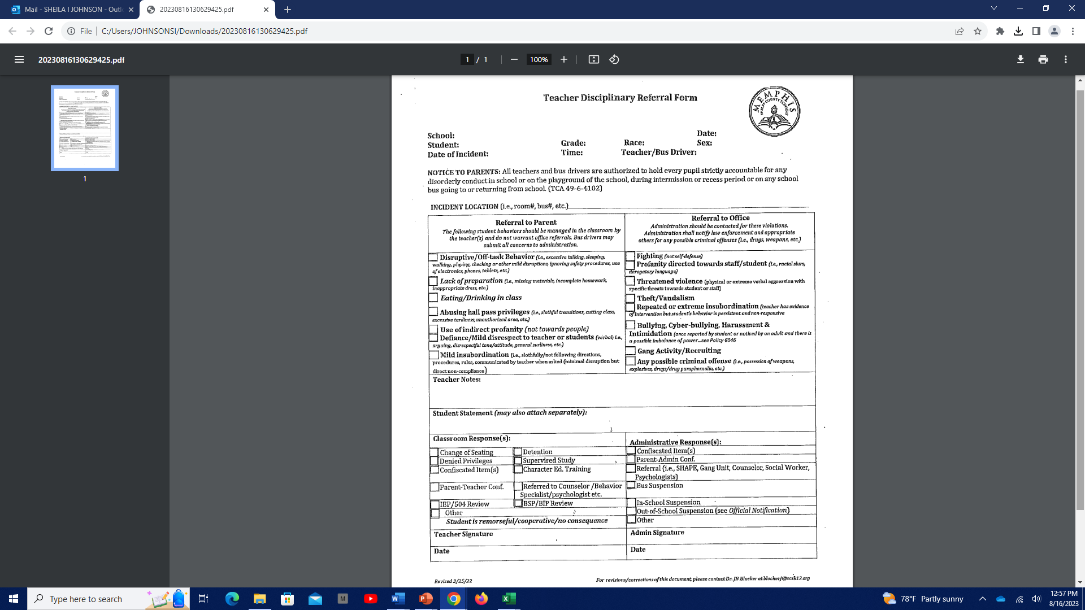
Teacher Disciplinary Referral
5 Conduct Slips

Slide 32

Extreme Behaviors
Categories that supersede the tracking process:
Fighting
Profanity towards the teacher or another student
Bullying
Inappropriate Touching

Slide 33

Student Support Team
The Student Support Team (SST) is a school team designed to assist students that may be struggling academically, behaviorally or emotionally at school, which is inhibiting the student in being successful.
The team is a positive, problem-solving intervention process which includes at least 3-5 people.

Slide 34
Student Referral Process
Identification
Child Find Law
Placement
Evaluation
SST or
S-Team
504, SPED (IEP),
No Placement

Slide 35
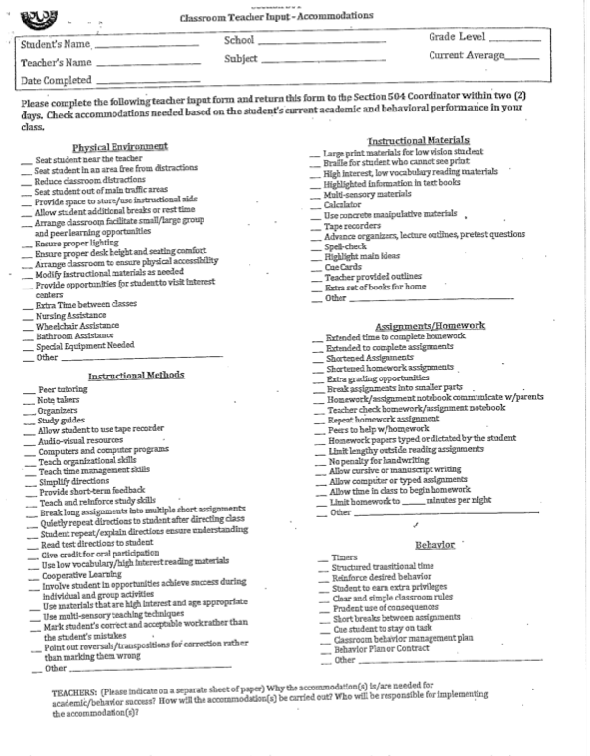
The 504 Plan
The 504 Plan is developed to ensure that a child who has a disability identified under the law and is attending an elementary or secondary educational institution receives accommodations that will ensure their academic success and access to the learning environment.

Slide 36


Who is eligible for 504?
Section 504 defines a person with a disability as anyone who
Has a mental or physical impairment which substantially limits one or more major life activities.
Has current medical record of such impairment.
The impairment must significantly limit one or more of the major life activities.
36
Notes:
All students with a disability are covered under the Section 504 law.

Slide 37


Attendance
100% Daily Student Attendance
*No Tardies*
Doors open at 8:00 a.m.
Breakfast is 8:00-8:15 a.m.
You are tardy/late at 8:16.

Slide 38


Uniform/Dress Code
Polo Shirt Colors
Pants/Skirts/
Shorts/Uniform Dresses
White/Black
Gold/Yellow
Navy Blue
No Logos
Shoes:
NO
Flip Flops
Tan
Khaki
Navy Blue
Black
No Denim

Slide 39

Bullying Overview:
What is bullying?
Bullying is when someone is being hurt either by words or actions on purpose, usually more than once, feels bad because of it, and has a hard time stopping what is happening to them.
Bullying includes actions such as making threats, spreading rumors, attacking someone physically or verbally, and excluding someone from a group on purpose.

Slide 40

Thank You!
We are looking forward to a successful 2023-2024 school year. Please let us know how we can help your student have the best possible experience.

